Slide 1
SPL-1 Presentation
Topic: Matrix Factorization
Presented by:
Ahnaf Mubashshir Mobin
BSSE-1232

Slide 2
Project Description
Addition of matrices
Subtraction of matrices
Multiplication of two matrices
Transpose matrix
Pseudo inverse of a matrix
Gaussian initialization
Matrix normalization
Error Calculation
Multiplicative Update

Slide 3
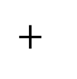
Addition of two matrices
Element-wise addition of two matrices.
A_{i,j}= (B_{i,j}) + (C_{i,j})
a | b
c | d
e | f
g | h
i | j
k | l
a+g | b+h
c+i | d+j
e+k | f+l
(3*3)
(3*3)
(3*3)

Slide 4
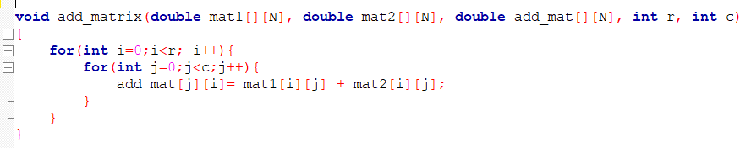
Addition of two matrices

Slide 5
Subtraction of two matrices
Element-wise subtraction of two matrices.
A_{i,j}= (B_{i,j}) - (C_{i,j})
a | b
c | d
e | f
g | h
i | j
k | l
a-g | b-h
c-i | d-j
e-k | f-l
(3*3)
(3*3)
(3*3)

Slide 6
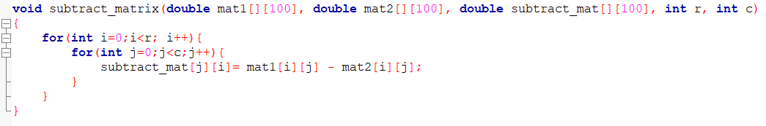
Subtraction of two matrices

Slide 7

Multiplication of two Matrices
A_{i,j}= (B_{i,k}) x (C_{k,j}) + (A_{i,k}) x (C_{k,j}) + (A_{i,k}) x (C_{k,j})
a | b | c
d | e | f
g | h
i | j
k | l
ag+bi+ck | ah+bj+cl
dg+ei+fk | dh+ej+fl
(2*3)
(3*2)
(2*2)

Slide 8
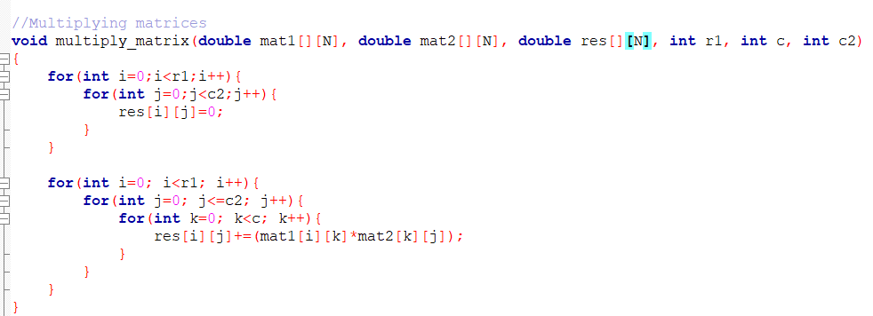
Multiplication of two Matrices

Slide 9
Transpose matrix
Transforming the row into columns and columns into rows.
a | b
c | d
e | f
A_{i,j}= A_{j,i}
a | c | e
b | d | f
(2*3)
(3*2)

Slide 10
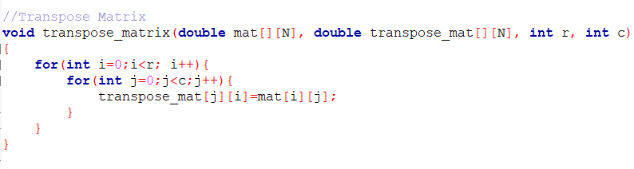
Transpose matrix

Slide 11
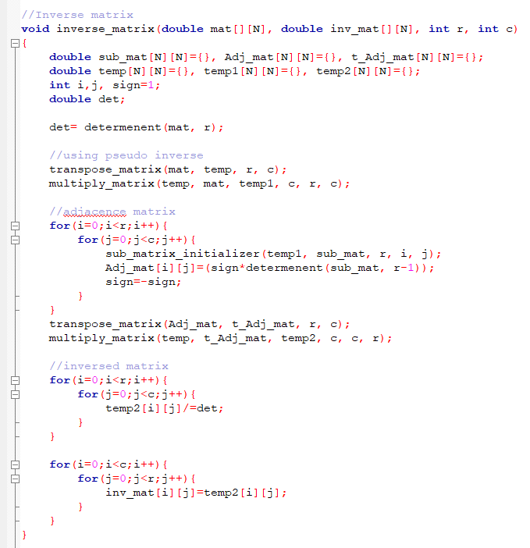
Pseudo inverse of a matrix
A matrix inverse-like object that may be defined for a complex matrix, even if it is not necessarily square
A⁺=(A^{T}xA)⁻¹xA^{T}

Slide 12
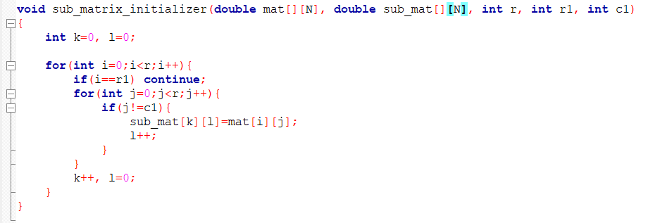
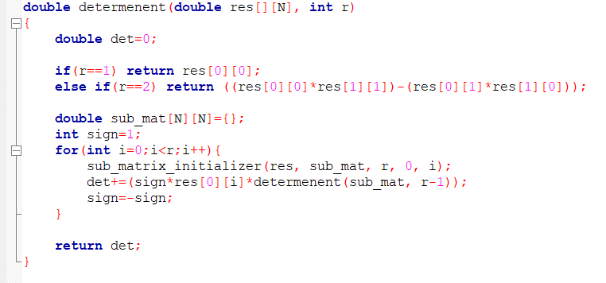
Pseudo inverse of a matrix
Determinant function
Finds the determinant of any matrix even its a non-square matrix.

Slide 13
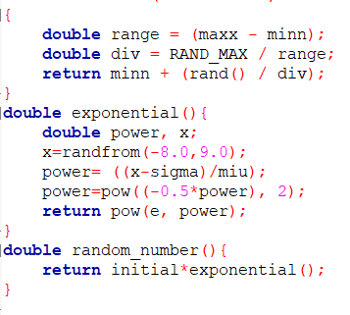
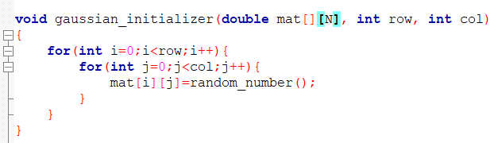

Gaussian Initialization
Initializing new two matrices using gaussian initializing formula.
$$f\left(x\right)=\frac{1}{σ\sqrt{2π}}e^{{−\frac{1}{2}\left(\frac{x−μ}{σ}\right)}^{2}}$$

Slide 14
Matrix Normalization
Normalizing the matrix by dividing every elements by Standard Deviation(SD).
$$σ(SD)=\sqrt{\frac{\sum{x_{i}{(−μ)}_{2}}}{N}}$$
$$A_{i,j}=\frac{A_{i,j}}{σ}$$
14 | 15 | 34
54 | 12 | 55
23 | 2 | 40
0.88 | 0.94 | 2.14
3.40 | 0.75 | 3.46
1.44 | 1.26 | 2.51

Slide 15
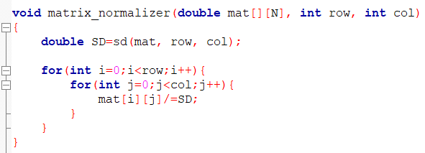
Matrix Normalization

Slide 16
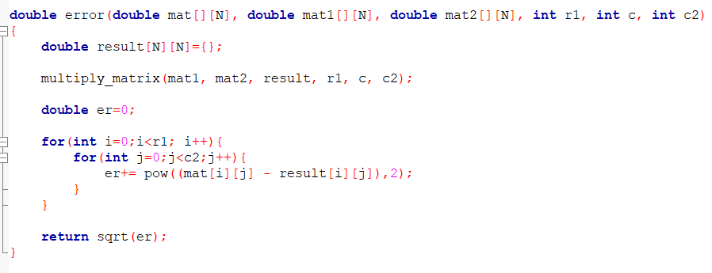
Error Calculation
Calculates element-wise error using .
error=$\sqrt{\sum{\text{\{}\text{Ai}\text{,}\text{j}\text{ − (}\text{Ai}\text{,}\text{jx} \text{Bi}\text{,}\text{j}\text{)\}}\text{2}}}$

Slide 17
What is matrix factorization?
A process by which a matrix is factorized into two different matrices in such a way that after multiplication them we get the parent matrix.
?? | ??
?? | ??
?? | ??
?? | ??
a | b | c
d | e | f
g | h | i
j | k | l
(4*2)
?? | ?? | ??
?? | ?? | ??
(2*3)
(4*3)

Slide 18
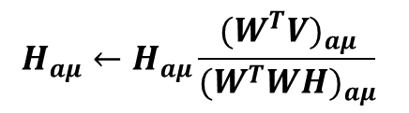
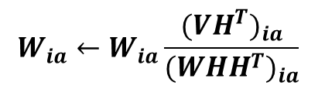
Multiplicative update
Let, V=WH where V is the initial matrix and W and H be the factorized matrix. The multiplicative update is ran using the given equation.
$$H_{aμ}←H_{aμ}\frac{{(W^{T}V)}_{aμ}}{{(W^{T}WH)}_{aμ}}$$
$$W_{ia}←W_{ia}\frac{{({VH}^{T})}_{ia}}{{({WHH}^{T})}_{ia}}$$
Here one matrix is kept constant and another one is changed as we try to get closer to the final value.

Slide 19
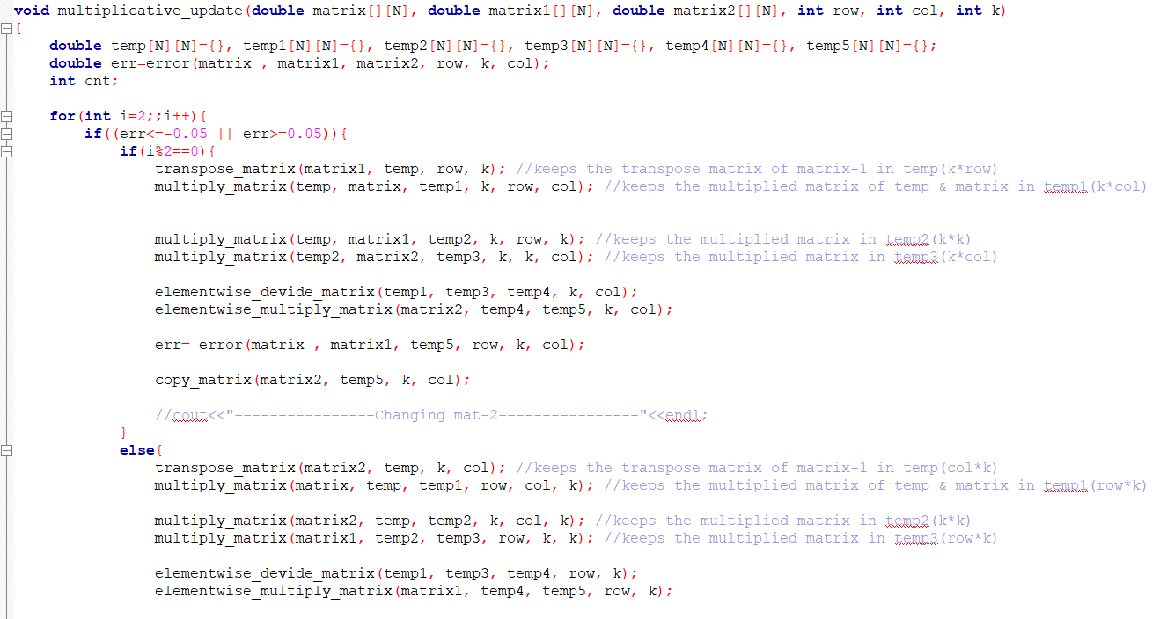
Multiplicative update

Slide 20
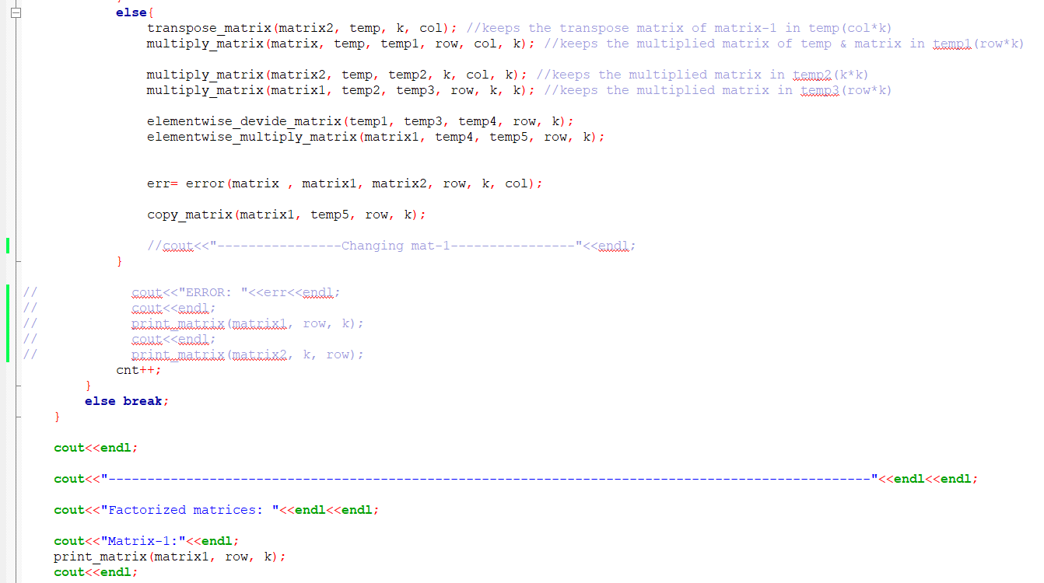
Multiplicative update

Slide 21
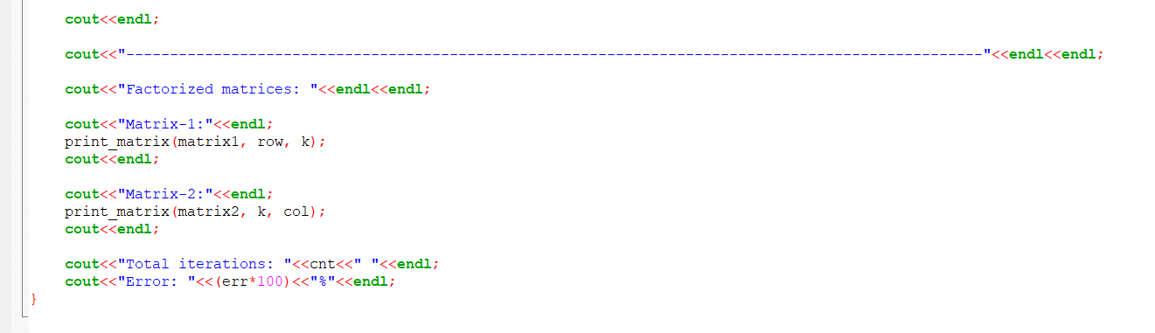
Multiplicative update

Slide 22
Thank You

